Slide 1
Processing inside Vision Sensor using Pixel Parallel SIMD Processor Array.
WES-237B
-Joey Schnecker,
Ryan Margraf,
Vinit Saah

Slide 2
Agenda
Introduction: SCAMP
Frame vs Event Camera
SCAMP History and Architecture
What is SIMD Processor Array
SIMD Processor with main CPU
More about SIMD Processor
How to develop for SIMD Processor
Application: Convolution Neural Network
Array semantics
Learning Addition and Subtraction
Convolution algorithm
Realtime Application
Q and A

Slide 3
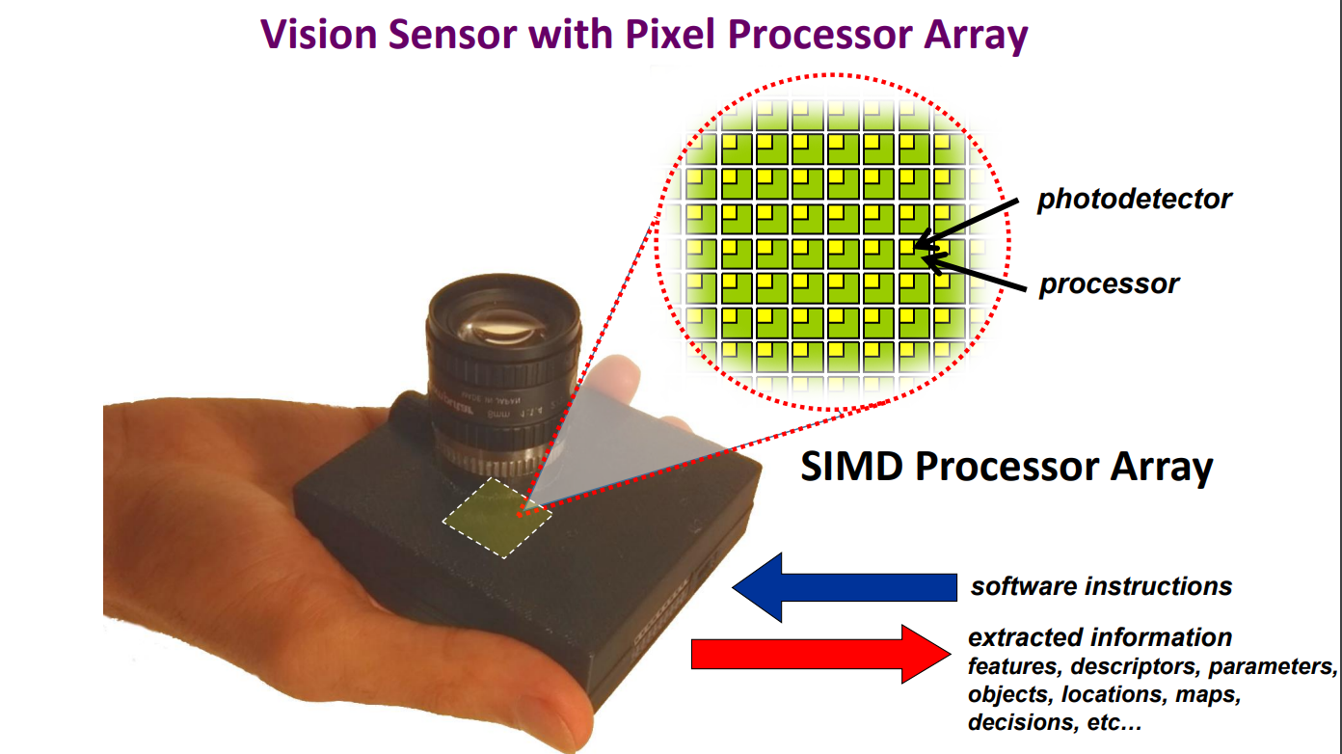
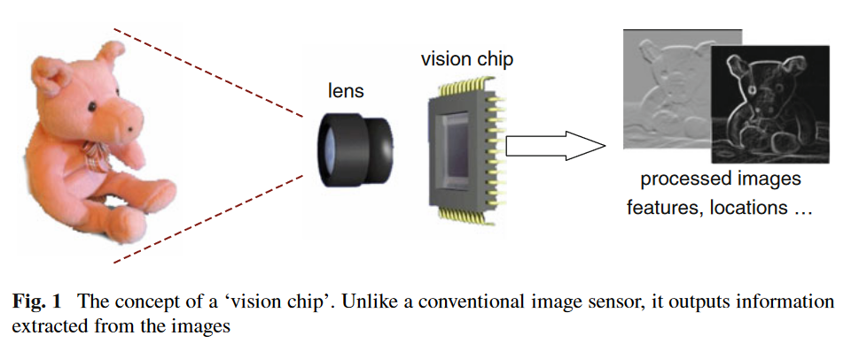
Introduction
SCAMP vision Sensor is a research sensor being developed by Piotr Dudek from University of Manchester (UK)
This sensor performs computation within the camera sensor
Each pixel has its own processor, allowing for SIMD operations on the entire pixel array
Allows for less data transfer compared to traditional camera, thus increasing speed while decreasing power consumption per operation.
https://www.youtube.com/watch?v=D3VcmkQiPR4
https://rpg.ifi.uzh.ch/CVPR19_event_vision_workshop.html

Slide 4
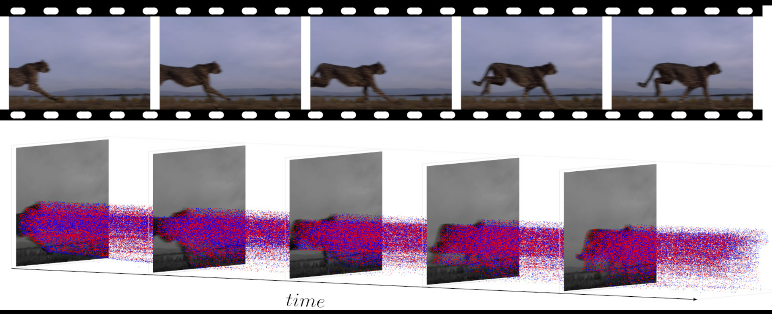
Event vs Frame Based Cameras
Traditional Cameras are frame based.
All pixels synchronously collect data (light), and store results into a frame
The entire frame, MxN pixels, is obtained from the sensor
Event based cameras are inspired by the human retina
Individual pixels collect data asynchronously
Pixels detect and report on changes in brightness
https://www.youtube.com/watch?v=MjX3z-6n3iA
https://en.wikipedia.org/wiki/Event_camera
https://www.youtube.com/watch?v=6xOmo7Ikwzk

Slide 5
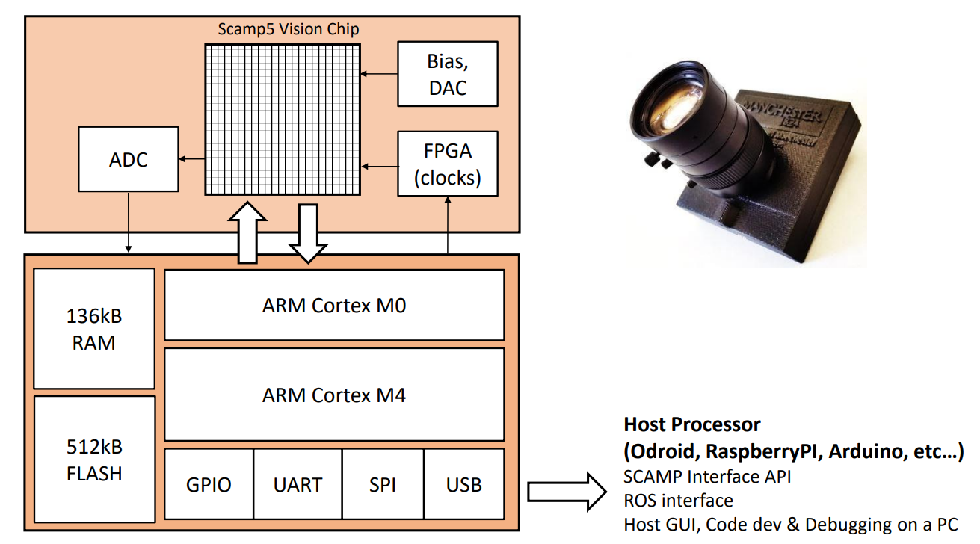
SCAMP Vision Sensor
SCAMP (SIMD Current-Mode Analog Matrix Processor)
A vision sensor capable of real time implementation of several computer vision algorithms
Compute occurs within the sensor and sends results to a micro-processor
For example, SCAMP can compute and send the results of Sobel edge detection directly to micro-processor

Slide 6
Evolution of SCAMP
1999: Analog SIMD Processor
https://personalpages.manchester.ac.uk/staff/p.dudek/papers/dudek-prep99.pdf
2000: General Purpose Analog Processor
https://personalpages.manchester.ac.uk/staff/p.dudek/papers/dudek-cas2000.pdf
2005: SCAMP
https://personalpages.manchester.ac.uk/staff/p.dudek/papers/dudek-tcasi2005.pdf
2011: SCAMP 3
https://personalpages.manchester.ac.uk/staff/p.dudek/papers/dudek-springer-book-2011.pdf
2013: SCAMP 5
https://personalpages.manchester.ac.uk/staff/p.dudek/papers/carey-vlsi2013.pdf
2019: SCAMP 5 for CNN
https://personalpages.manchester.ac.uk/staff/p.dudek/papers/bose-iccv2019.pdf
2022: SCAMP 5 for Robotics Applications
https://www.science.org/stoken/author-tokens/ST-625/full
SCAMP Overview​
https://personalpages.manchester.ac.uk/staff/p.dudek/scamp/default.htm​
SCAMP Publications
https://personalpages.manchester.ac.uk/staff/p.dudek/papers/
Video Demonstrations
https://sites.google.com/view/project-agile/demos-and-videos/

Slide 7
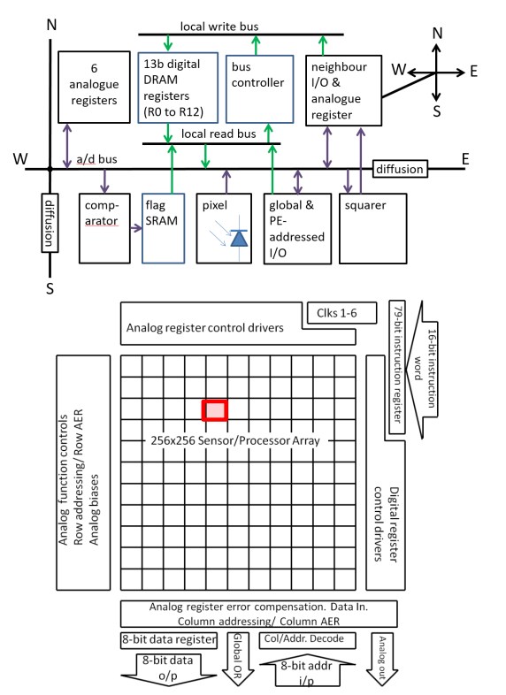
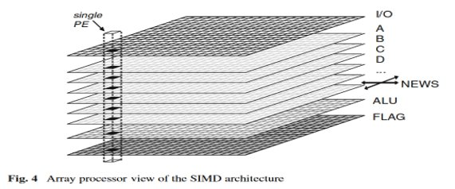
SCAMP Architecture Overview
Sensor is made up of an array of Pixel Elements (PE)
Array architecture allows for hardware level SIMD calculations on the entire image.
Each Pixel element has its own mixed signal processor for performing calculations
Literature claims each PE has a small Turing-complete processor
Each Pixel Element (PE) contains:
6 general purpose analog registers
4 Special purpose registers (ALU)
13 bytes General Purpose DRAM

Slide 8
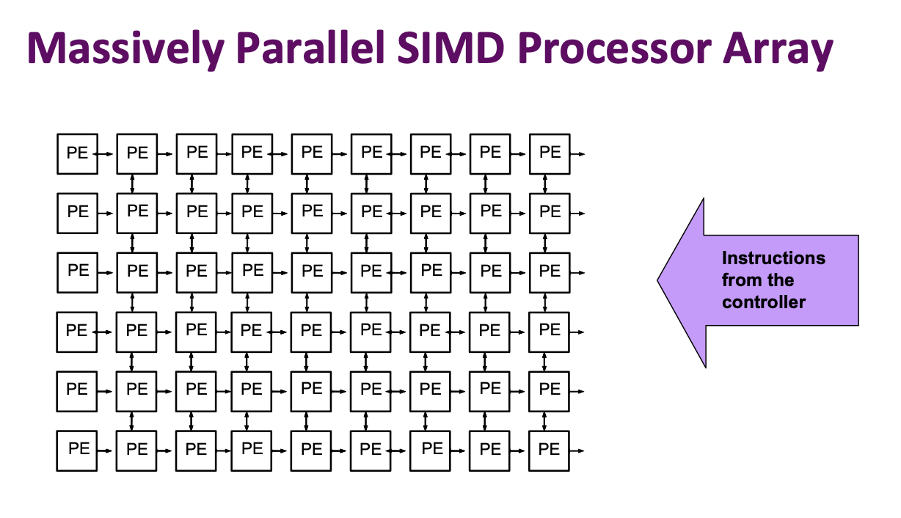
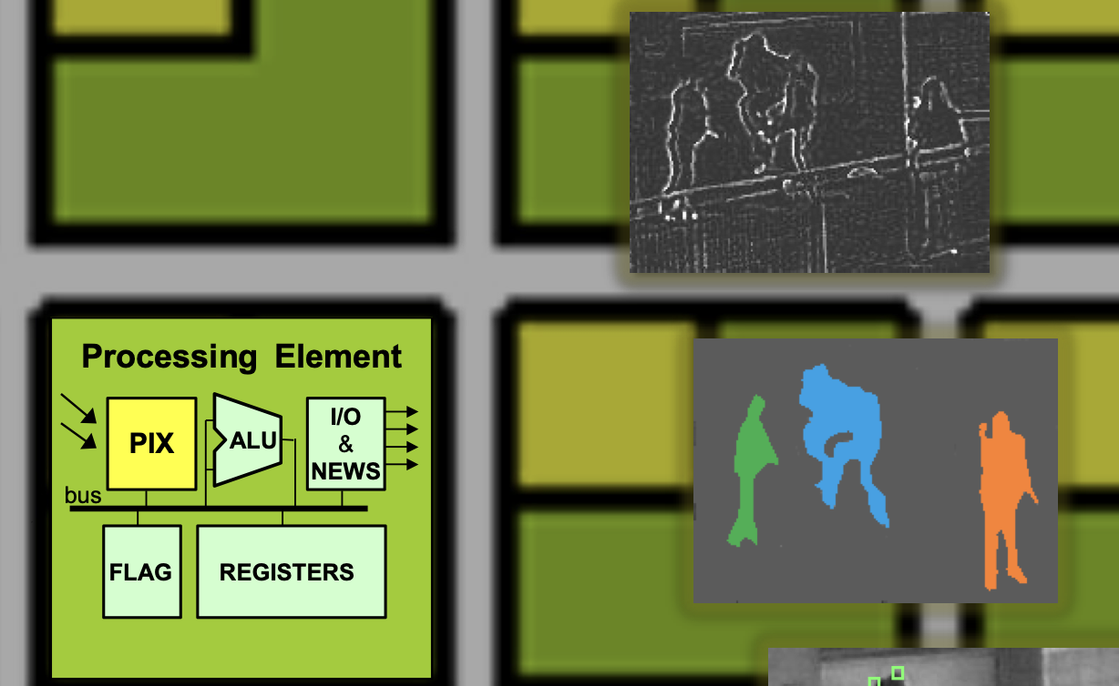
SIMD Array Details
All processors (PEs) perform the same operation (Single Instruction) operating on their local data (Multiple Data)

Slide 9
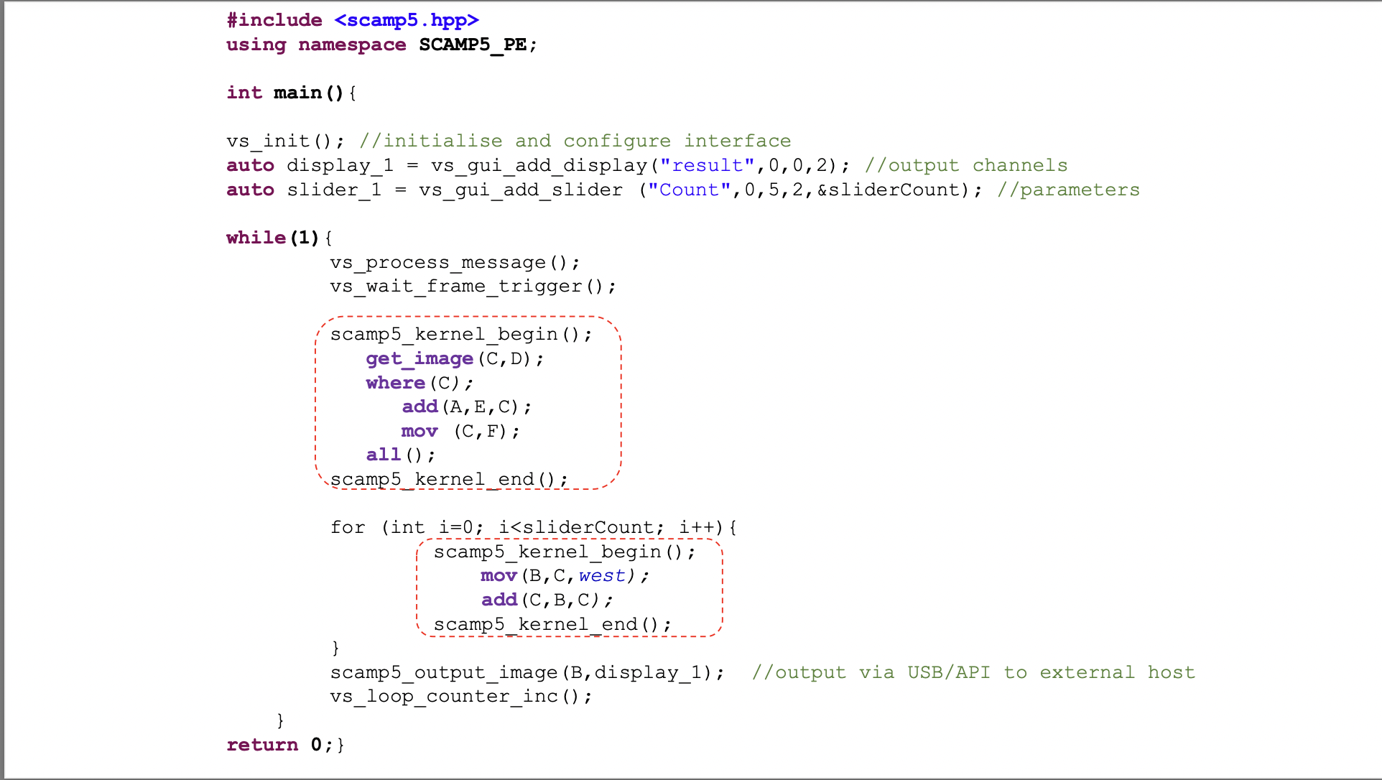
Programming SIMD Array Details
University Project.
Usually, the camera code runs on Main CPU.
Inline code to run on Sensors.
Similar to CUDA programming.
Instructions are simple assembly language.
Regular compiler to compile
Reason for assembly, Research group is still working on compiler.
logical instructions, OR, AND, or NOT
arithmetical instructions, (add), (sub), or division (div2)
shifting instructions

Slide 10
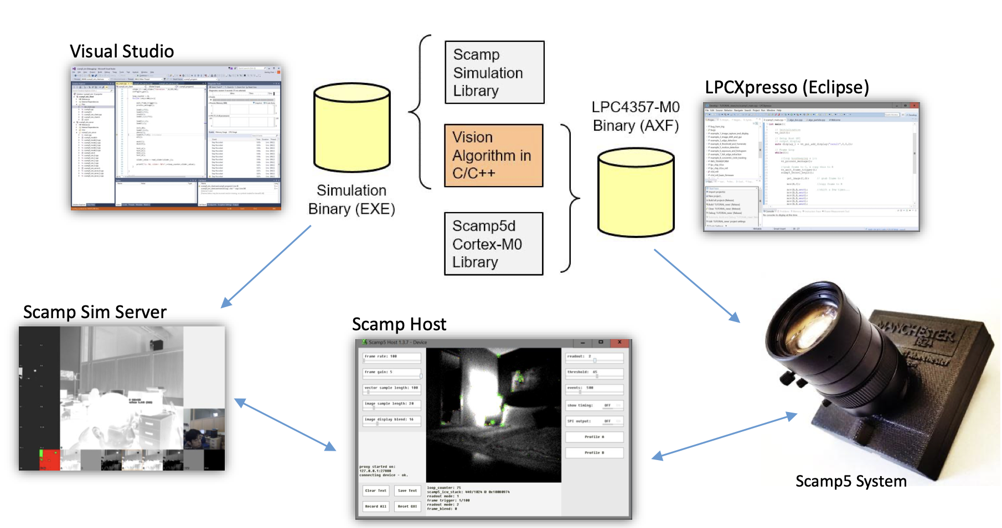
SDK
https://scamp.gitlab.io/scamp5d_doc/modules.html
https://scamp.gitlab.io/scamp5d_doc/_p_a_g_e__d_e_v_i_c_e__a_p_i__c_a_t_e_g_o_r_y.html

Slide 11
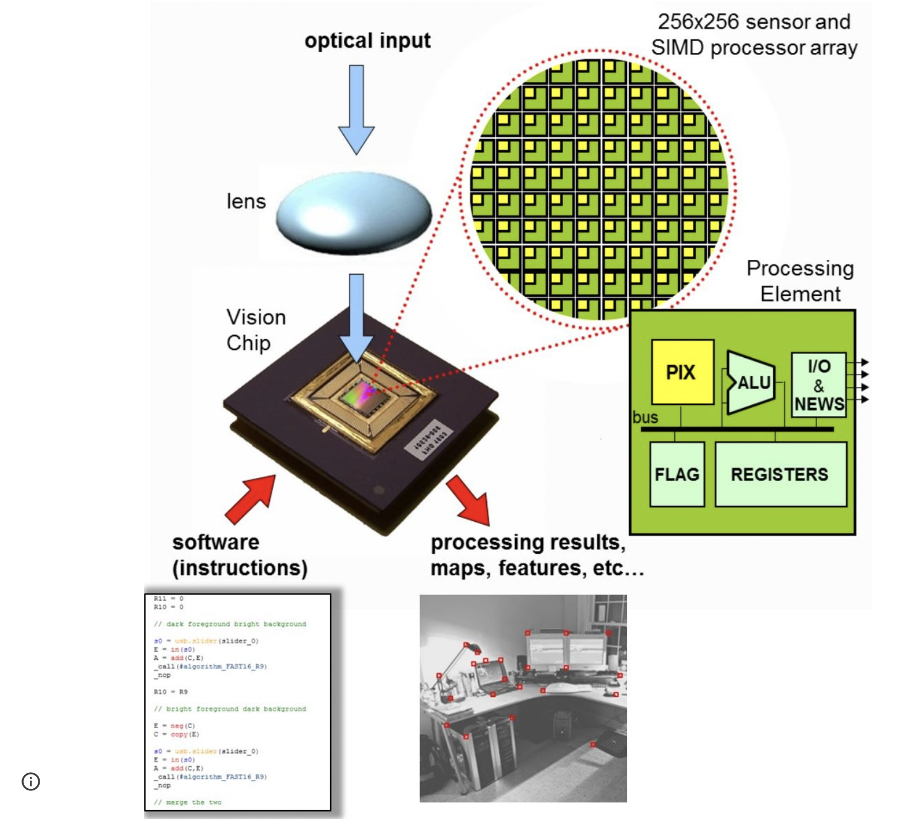
Just to summarize
each image pixel contains a processor
processors are software-programmable – they execute code
all computations are done on the sensor – in a pixel-parallel array – no sensor/processor/memory data movements – high speed & low power
operation is “frame based” – but the frame rate can be very high – many kHz (Exception to general Event Based)
Only interesting data is transmitted off chip
– results of computations,
– e.g. 2D maps, global measures, address-events of points of interest,

Slide 12
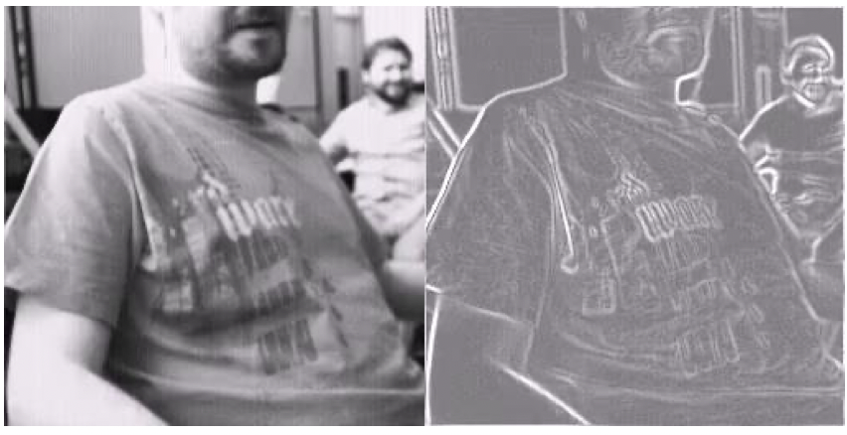
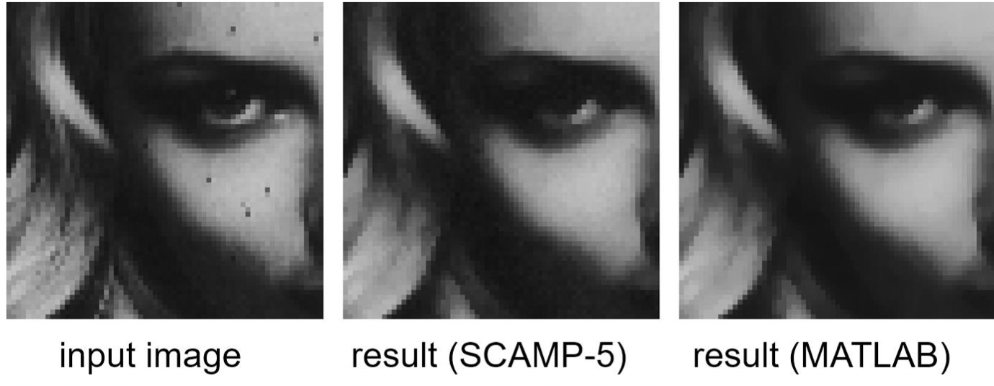
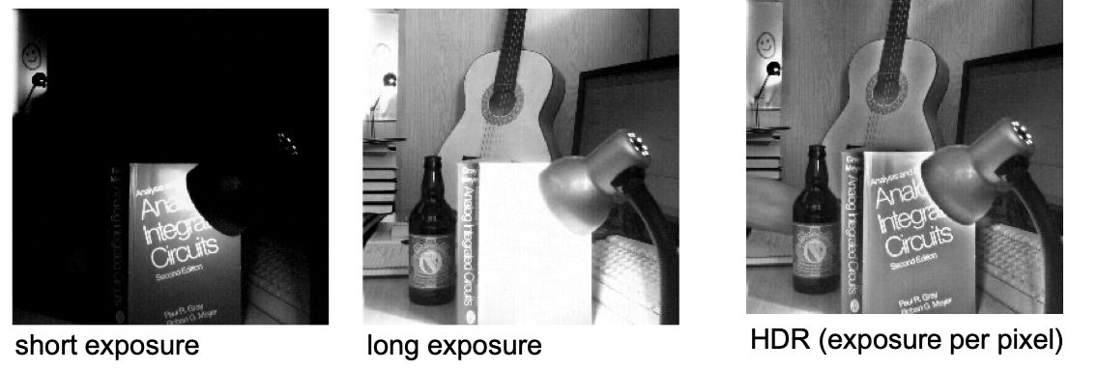
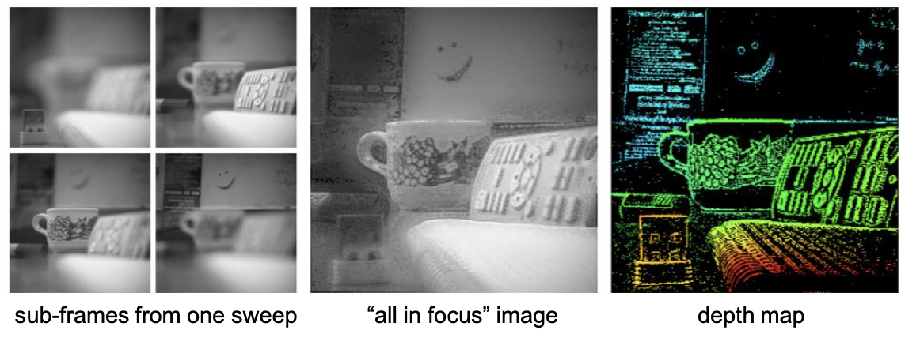
Application
Basic algorithm such as Edge detector
execution time 5.8 µs,
implemented in 15 instructions of add, subtract and shifting.
Median filter: Result Sensor and Matlab
more complicated, involves sorting of 3*3 pixels: 20.1 µs
HDR: Capturing multiple frames to equalize brightness. Zero latency, processed during image integration
Depth Focus: Capturing multiple frames and finding the focal point.

Slide 13
Convolutional Neural Networks (CNN)
Paper by
Laurie Bose1 Jianing Chen2 Stephen J. Carey2 Piotr Dudek2 Walterio Mayol-Cuevas1 1University of Bristol, Bristol, United Kingdom 2University of Manchester, Manchester, United Kingdom
Link:
https://arxiv.org/pdf/1909.05647.pdf

Slide 14
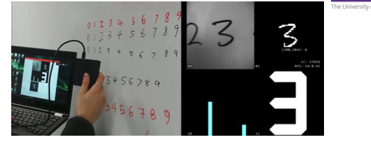
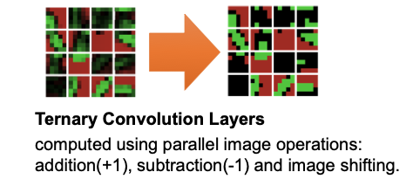
Convolutional Neural Networks (CNN) Details
Revolutionized Computer Division discipline.
Requirements of Neural network surpass capability of embedded microprocessors.
So accelerators are required.
Images to be processed at sensor. No memory transfer to main processing unit.
Sparse output are sent to main Processing unit instead of complete frame.
Results in data reduction and power efficiency
Divides the array in 4*4 block, trading- off image resolution, for increased local memory.
Logical operations, processes the data, stores the result, and transfers the sub-sampled data to attached system.

Slide 15
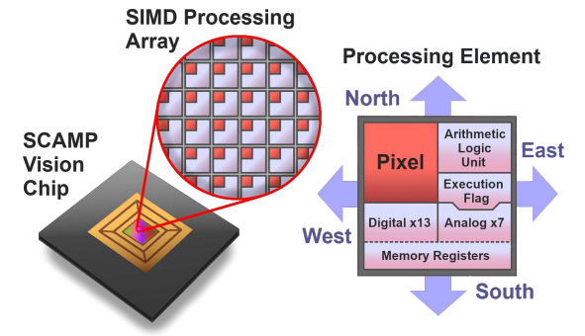
Pixel Processor Array
Each pixel has:
6 registers for analog data
13 bits for digital data
ALU
Analog
Faster, but noisy
Operations: Add, negate, split, compare against 0
Digital
Operations: MOV, OR, NOR, NOT
Each pixel has connections to its 4 directly adjacent neighbors

Slide 16
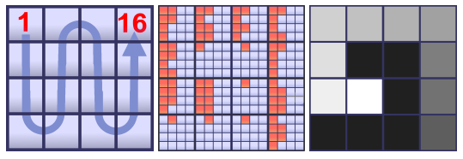
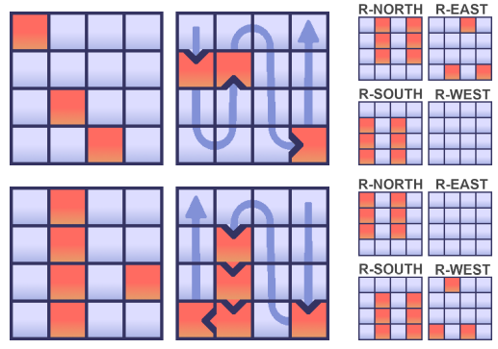
Alternative Arrangement
To save bits for other operations, one may consider grouping pixels into 4x4 blocks
Decreases image size to 64x64, but only uses 1 bit per pixel (16 bits per block)
Can still perform bit shifts, as well as other operations

Slide 17
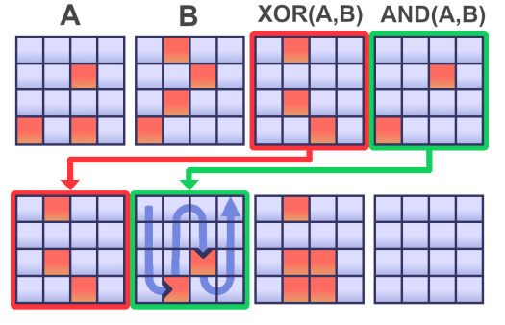
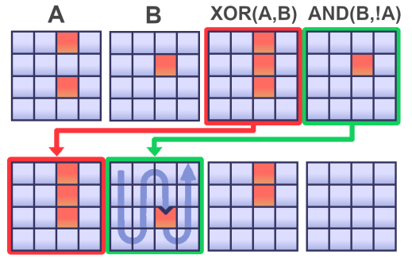
Addition and Subtraction
Uses a combination of AND, XOR, and bit shifts
Algorithm: Addition of two images A and B
Generate 2 intermediate results AND(A,B) and XOR(A,B)
If AND(A,B) is all 0s (no carry bits), result is XOR(A,B)
Otherwise, set A = XOR(A,B) and B = ShiftLeftBy1(AND(A,B)) and repeat
Continue until AND(A,B) is all 0s (no more carrying)
Subtraction
Same as addition except A is inverted before each AND operation

Slide 18
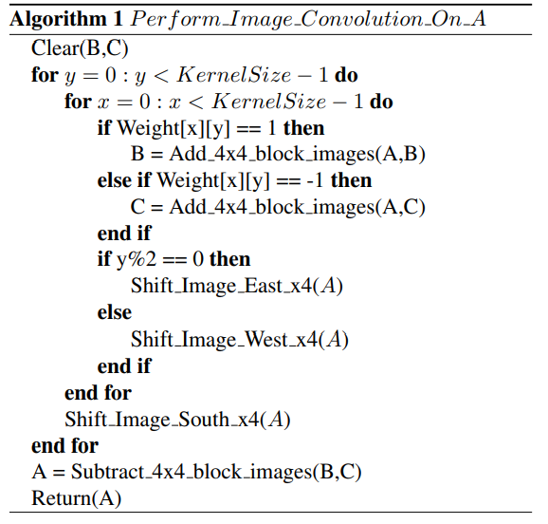
Convolution
Restricting weights to values of 1,0, and -1 provides some benefits
This allows the convolutions to be implemented with only addition and subtraction, rather than the more costly multiplication
Algorithm:
Iterate over kernel, separately accumulating the positive and negative results in different images
At the end, subtract the accumulated negative values from the positive ones

Slide 19
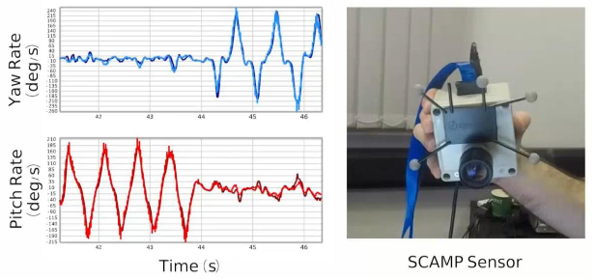
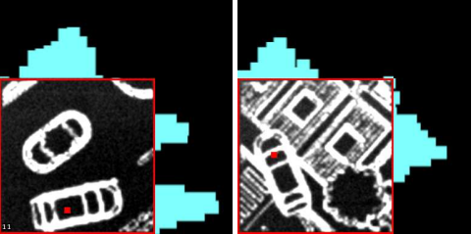
Applications
Edge detection
Corner detection (up to 2000 FPS)
Object Tracking (100,000+ FPS)
Visual Odometry
Convolutional Neural Networks
Digit Classification
Car Tracking

Slide 20
Credits and references
Piotr Dudek
https://rpg.ifi.uzh.ch/CVPR19_event_vision_workshop.html
Presentation at CVPR Event Vison Workshop: https://www.youtube.com/watch?v=D3VcmkQiPR4
Bose et al. (2019). A Camera That CNNs: Towards Embedded Neural Networks on Pixel Processor Arrays. 1335-1344. 10.1109/ICCV.2019.00142.
Documentation: https://scamp.gitlab.io/scamp5d_doc/index.html
Demonstrations: https://sites.google.com/view/project-agile/demos-and-videos

Slide 21
BACKUP

Slide 22
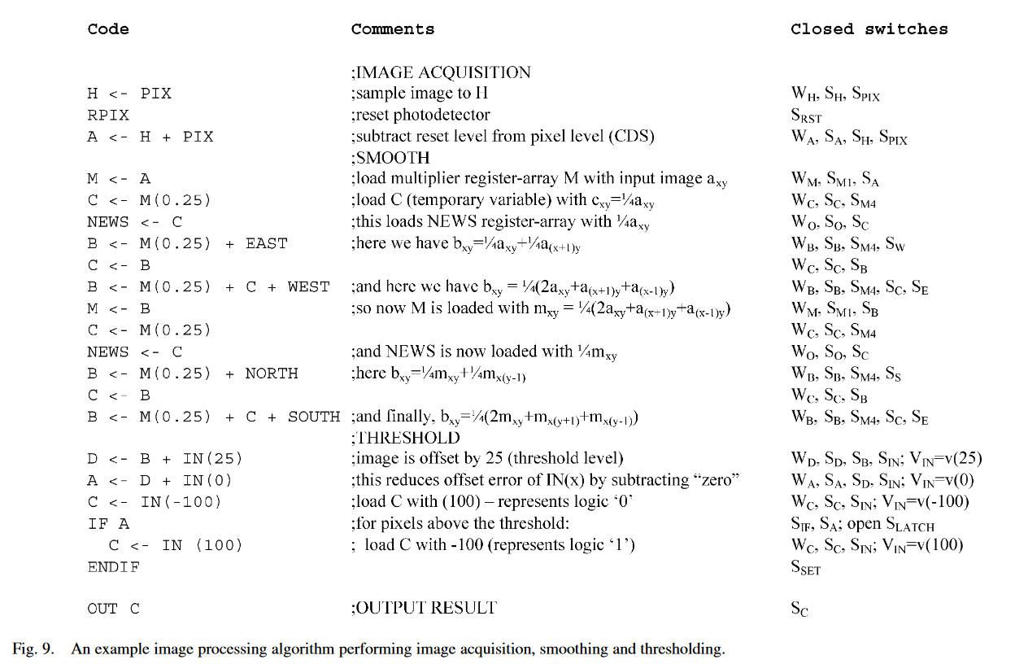
Pseudo Code

Slide 23
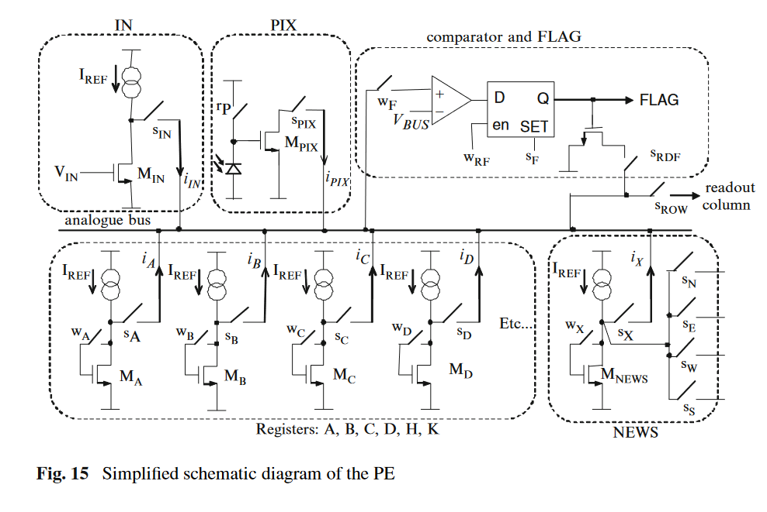
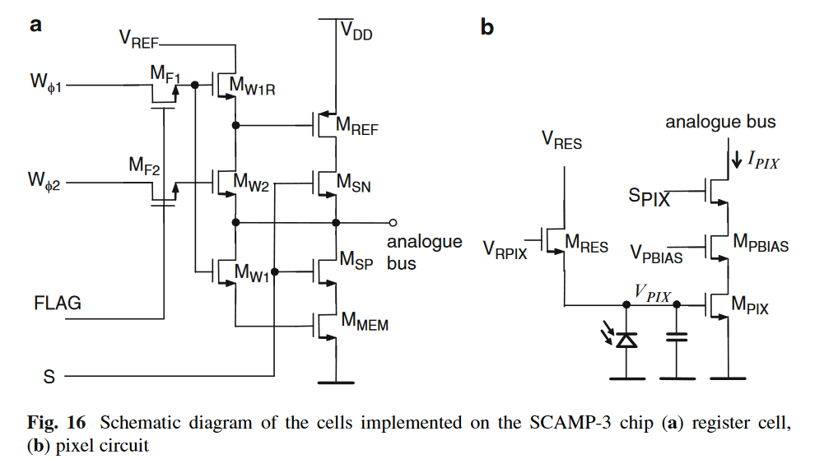
SCAMP Architecture Detail
https://personalpages.manchester.ac.uk/staff/p.dudek/papers/dudek-tcasi2005.pdf
https://personalpages.manchester.ac.uk/staff/p.dudek/papers/dudek-springer-book-2011.pdf

