Slide 1
Reducing the Complexity of Hyperparameter Tuning

Slide 2
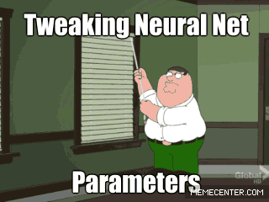
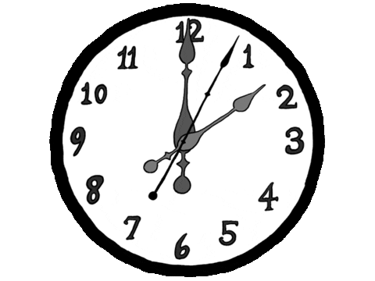
Training a Neural Network is Time Consuming and Complex

Slide 3
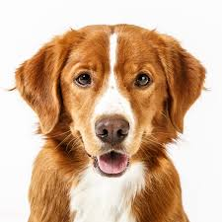
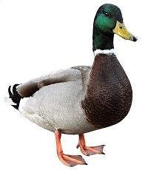
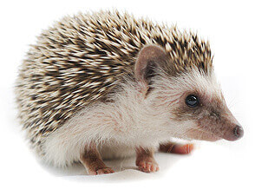
Neural Network – Inference
correct
labels
inputs
outputs
Dog
12
145
0
55
243
36
27
44
145
105
100
32
188
23
59
7
238
99
4
255
0
1
28
109
94
165
19
Plus biases
Multiply by weights
Hedgehog
Dog
Duck
Duck
Hedgehog

Slide 4
Neural Network – Train
$$q(θ,x)$$
correct
labels
inputs
Multiply by weights
outputs
$θ$: Network parameters
(weight, bias, etc.)
Plus biases
$$x_{1}$$
Duck
$$q(θ,x_{1})$$
$$l_{1}$$
Dog
Dog
$$q(θ,x_{2})$$
Duck
$$x_{2}$$
$$l_{2}$$
$$q(θ,x_{3})$$
Hedgehog
Hedgehog
$$l_{3}$$
$$x_{3}$$
Loss function: $\frac{1}{3}\sum_{i=1}^{3}{|q\left(θ,x_{i}\right)−l_{i}|}$
correct
labels
Loss function: $F(θ)$
Loss function=average(outputs - )

Slide 5
Neural Network – Train
$$q(θ,x)$$
correct
labels
inputs
outputs
$θ$: Network parameters
(weight, bias, etc.)
$$x_{1}$$
$$q(θ,x_{1})$$
$$l_{1}$$
$$x_{2}$$
$$q(θ,x_{2})$$
$$l_{2}$$
$$q(θ,x_{3})$$
$$l_{3}$$
$$x_{3}$$
Loss function: $F(θ)$
Backpropagation($φ,∇F(θ)$)
$φ$: parameters used for
backpropagation calculations
Backpropagation: use $∇F(θ)$
and adjust $θ$ to reduce loss
Optimization Parameters
Training Parameters
Hyperparameters
Derivative of
Loss function: $∇F(θ)$

Slide 6
Neural Network – Train
Generate output using
Network parameters ($θ$)
correct
labels
inputs
$$q(θ,x)$$
outputs
$θ$: Network parameters
(weight, bias, etc.)
$$x_{1}$$
$$q(θ,x_{1})$$
$$l_{1}$$
$$x_{2}$$
$$q(θ,x_{2})$$
$$l_{2}$$
$$q(θ,x_{3})$$
$$l_{3}$$
$$x_{3}$$
Loss function: $F(θ)$
Backpropagation: using $∇F(θ)$
and Hyperparameters we
adjust our network parameters
Derivative of
Loss function: $∇F(θ)$

Slide 7
Neural Network – Train
Generate output using
Network parameters ($θ$)
Loss: $F(θ)$
$F(θ_{0})$
Loss function: $F(θ)$
Backpropagation: using $∇F(θ)$
and Hyperparameters we
adjust our network parameters
step
step
step
Start at: $θ_{0}$
step

Slide 8
Neural Network – Training can take some time…
Generate output using
Network parameters ($θ$)
Depending on network, data,
and hardware, this can take
hours, days, or weeks!
Loss: $F(θ)$
what if this
decay is too
slow for us?
$F(θ_{0})$
should we start
from a different
location?
did we stop
too early?
should we change
our training script?
But what if we don’t
like the result!?
We have to repeat this
after changing
Hyperparameters!
what if our
customer says this
error is too high?
$F(θ_{n})$
Backpropagation: using $∇F(θ)$
and Hyperparameters we
adjust our network parameters
Backpropagation: using $∇F(θ)$
and Hyperparameters we
adjust our network parameters
Start at: $θ_{0}$
Stop at: $θ_{n}$
step

Slide 9
Lets use Accuracy Instead of Loss
Loss: $F(θ)$
Accuracy
step

Slide 10
Aiming to Save Time and Resources
If: we reduce the number of tunable hyperparameters (M<N) then: we have less to tune manually
Red:
by tuning M
hyperparameters
Accuracy
Green:
by tuning N
hyperparameters
step

Slide 11
Aiming to Save Time and Resources
If: we reduce the number of tunable hyperparameters (M<N) then: we have less to tune manually
If: we achieve a minimum accuracy, faster then: we will be able to test more ideas*
Red:
by tuning M
hyperparameters
Accuracy
Green:
by tuning N
hyperparameters
step
this is great!
can we have this?
* Only when you care about achieving a minimum accuracy

Slide 12
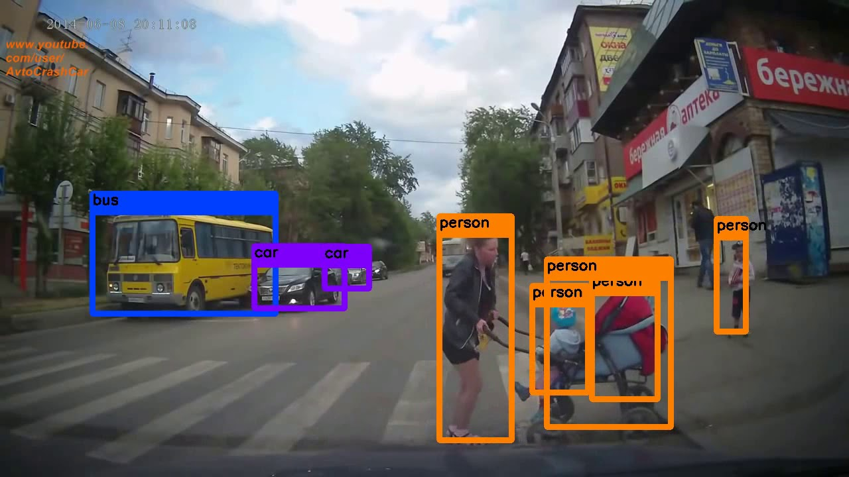
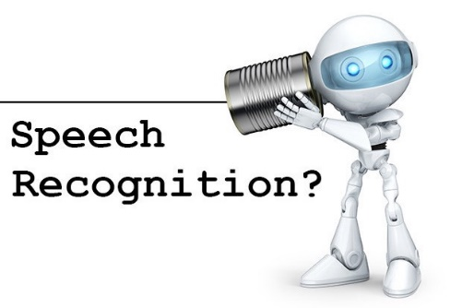
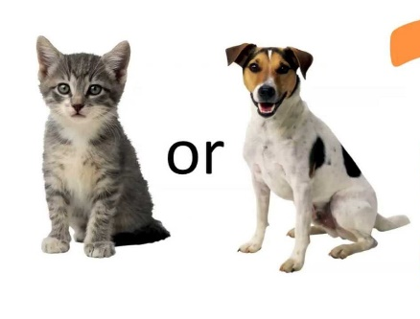
There are many Applications for NN
Financial forecasting
Object recognition
Speech
recognition
Medical diagnosis
Image classification

Slide 13
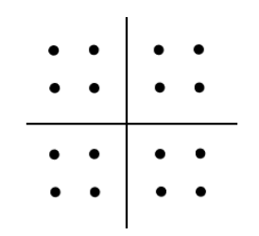
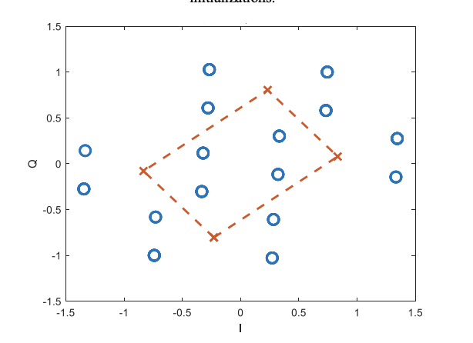
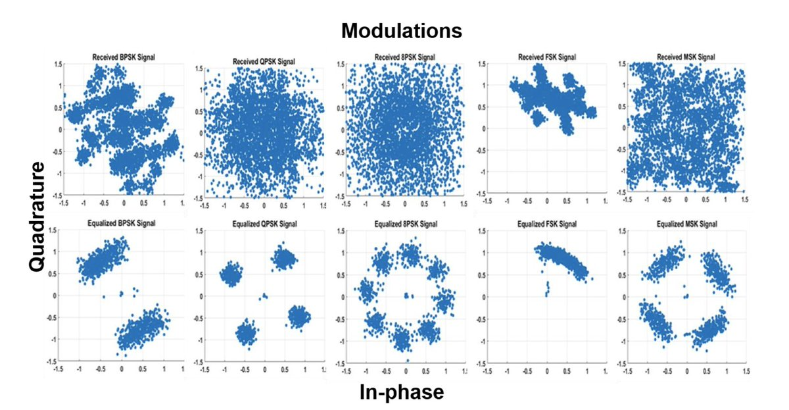
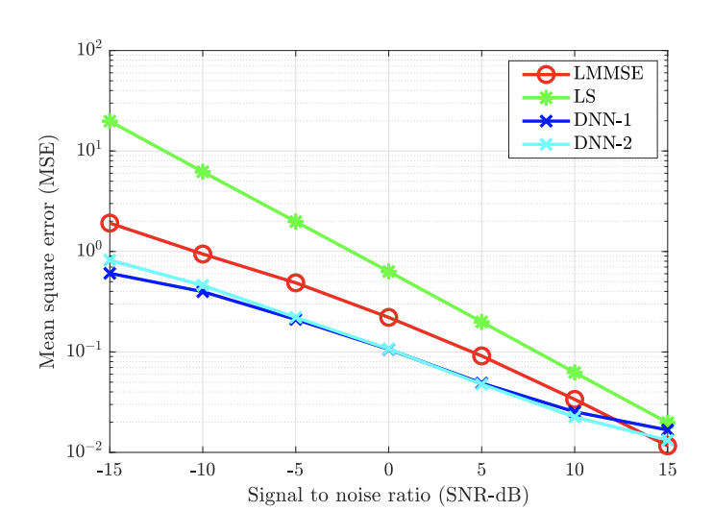
Telecommunication Applications for NN
Constellation design
Automatic modulation classification
Channel estimation

Slide 14
There are Different Network Topologies

Slide 15
After Selecting Application, Dataset, and Network
How complex is training?
Dataset
(application, network, dataset)
Network
Application

Slide 16
The Complexity of Training a Neural Network
How to evaluate our
Network? MSE, MAE, CEL, …
How to initial our
Network?
random, He, Xavier, …
When do we stop?
maximum number of epochs,
minimum accuracy, …
Start with:
How to modify our
input?
normalizing, crop, flip, …
Application
Dataset
Network
How to Quantize?
bit budget, method, …
How to change our
Network variables?
Optimizer, learning rate, …
there exists a set of suggestions, but no definite answer
* This graph is generalized and simplified

Slide 17
The Complexity of Training a Neural Network
How to evaluate our
Network? MSE, MAE, CEL, …
How to initial our
Network?
random, He, Xavier, …
When do we stop?
maximum number of epochs,
minimum accuracy, …
Start with:
How to modify our
input?
normalizing, crop, flip, …
Application
Dataset
Network
How to Quantize?
bit budget, method, …
How to change our
Network variables?
Optimizer, learning rate, …
Answer to each question depends on other answers!
* This graph is generalized and simplified

Slide 18
The Complexity of Training a Neural Network
How to evaluate our
Network? MSE, MAE, CEL, …
How to initial our
Network?
random, He, Xavier, …
When do we stop?
maximum number of epochs,
minimum accuracy, …
Start with:
How to modify our
input?
normalizing, crop, flip, …
Application
Dataset
Network
How to Quantize?
bit budget, method, …
How to change our
Network variables?
Optimizer, learning rate, …
Training a 3-Node Neural Network is NP-Complete
A. Blum and R. L. Rivest, NIPS 1989
Answer to each question depends
on other answers!
For example learning rate and optimizer can depend on quantization
“Training a Neural Network to Produce the correct output is NP-Hard”
S. Judd, PhD Thesis 1988
* This graph is generalized and simplified

Slide 19
The Complexity of Training a Neural Network
Reducing The Complexity of Training
Let’s say we select these parameters
for an experiment:
Let’s say we select these parameters
for an experiment:
Evaluation:
CEL
Evaluation:
CEL
Application
Dataset
Network
Stop criteria:
maximum number of epochs
Application
Dataset
Network
Initialization:
random
Initialization:
random
Modify input
normalizing, crop, flip, …
Quantization:
bit budget, method, …
Quantization:
bit budget, method, …
How to change our
Network variables?
Optimizer, learning rate, …
Modify input
normalizing, crop, flip, …
Stop criteria:
maximum number of epochs
Automatically tune
some of these parameters
How to change our
Network variables?
Optimizer, learning rate, …
still no definite answer, but there exists a better set of suggestions
* This graph is generalized and simplified

Slide 20
Training a Network
Generate output using
Network parameters ($θ$)
Backpropagation: using $∇F(θ)$
and hyperparameters we
adjust our network parameters ($θ$)
Backpropagation: using $∇F(θ)$
and hyperparameters we
adjust our network parameters

Slide 21
Training a Network – Gradient Descent
learning rate
updated values
$$θ_{i+1}=θ_{i}−λ∇F(θ_{i})$$
current values
derivative of loss function
using all the training set
Backpropagation: using $∇F(θ)$
and hyperparameters we
adjust our network parameters ($θ$)

Slide 22
Training a Network – A Simple Example
learning rate
$$θ_{i+1}=θ_{i}−λ∇F(θ_{i})$$
current values
derivative of loss function
using all the training set
$$x^{4}$$
$$w_{4}$$
Let’s learn the following parameters:
$$y=b+w_{1}x+w_{2}x^{2}+w_{3}x^{3}+w_{4}x^{4}$$
$$x^{3}$$
$$w_{3}$$
$$x^{2}$$
$$w_{2}$$
$$∑$$
$$y$$
$$x$$
$$w_{1}$$
We like to learn the following parameters:
$$y=−2.2+3.1x+0.3x^{2}+1.3x^{3}+3.3x^{4}$$
$$b$$

Slide 23
Training a Network – A Simple Example
Blue: goal
Red: training with non-fixed learning rate
Blue: goal
Green: training with fixed learning rate
Output
($y$)
$$x$$
$$x$$
$$b$$
$$w_{3}$$
$$b$$
$$w_{3}$$
Parameters
$$w_{1}$$
$$w_{1}$$
$$w_{2}$$
$$w_{2}$$
$$w_{4}$$
$$w_{4}$$
Learning
rate
step
step

Slide 24
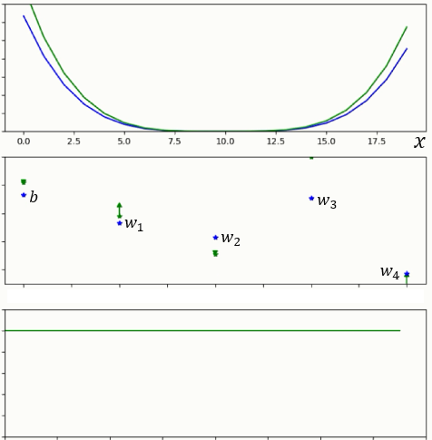
Training a Network – A Simple Example
Blue: goal
Red: training with non-fixed learning rate
Blue: goal
Green: training with fixed learning rate
Output
($y$)
$$x$$
$$x$$
$$b$$
$$w_{3}$$
$$b$$
$$w_{3}$$
Parameters
$$w_{1}$$
$$w_{1}$$
$$w_{2}$$
$$w_{2}$$
$$w_{4}$$
$$w_{4}$$
Learning
rate
step
step

Slide 25
Training a Network – We Need Tuning
Bag of tunable
learning rate
$$θ_{i+1}=θ_{i}−λ∇F(θ_{i})$$
$$λ$$
current values
derivative of loss function
using all the training set

Slide 26
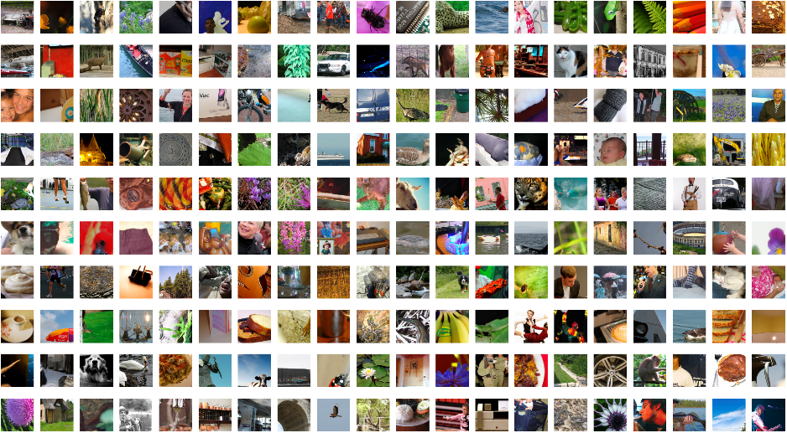
Training a Network – Gradient Descent
Training a Network – Stochastic Gradient Descent
Bag of tunable
learning rate
$$λ$$
$$θ_{i+1}=θ_{i}−λ∇F(θ_{i})$$
$$θ_{i+1}=θ_{i}−λg(θ_{i})$$
derivative of loss function
using a subset of training set
current values
derivative of loss function
using all the training set
b
Subset size = b
sample
How to sample?
ImageNet training set includes one million 224x224 images

Slide 27
Training a Network – Generalization
Bag of tunable
learning rate
$$λ$$
$$θ_{i+1}=θ_{i}−λg(θ_{i})$$
b
sample
current values
derivative of loss function
using a subset of training set
Weight Decay
A Simple Weight Decay can Improve Generalization, Krogh, A. and Hertz, J. NIPS 1991
These sets are different!
We may overfit on train and/or validation sets, if not careful!
Train set
Test set
ImageNet training set includes one million 224x224 images
Validation set

Slide 28
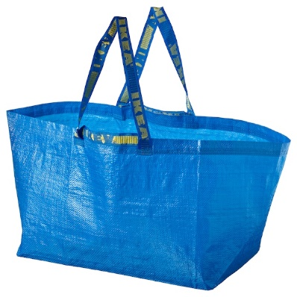
Training a Network – Too many Hyperparameters!
Bag of tunable
learning rate
$$λ$$
b
$$θ_{i+1}=θ_{i}−λg(θ_{i})$$
sample
derivative of loss function
using a subset of training set
Weight Decay
current values
We can continue and introduce more and more parameters
$$∇F{\left(θ\right)}^{T}d,$$
Hessian Free
warmup
$$F\left(θ,d\right)=$$
cooldown
$$b_{k+1}=\frac{Hb_{k}}{\left|\left|Hb_{k}\right|\right|}$$
Step decay
$$\left||d|\right|≤ε$$
ADAM
gamma
momentum
$$θ_{i+1}=θ_{i}−λ\frac{\hat{m_{i}}}{\sqrt{{\hat{V}}_{i}}+ε}$$
$$V_{i}=βV_{i−1}+\left(1−β\right)g(θ_{i})$$
milestones
$$E_{q\left(x | θ\right)}\{∇\log{q\left(x | θ\right)}∇\log{q{\left(x | θ\right)}^{T}\}}$$
dampening
Cyclic Learning Rate
Nesterov momentum
RMSPROP
AdaBound
KFAC
$$θ_{i+1}=θ_{i}−λ\frac{g\left(θ_{i}\right)}{√V_{i} }$$
$\hat{η_{i}}=Clip(\frac{λ}{\sqrt{{\hat{V}}_{i}}}, η_{l}\left(i\right), η_{h}\left(i\right))$
$$G\left(θ\right)=V⊗U$$
Maximum learning rate
Initial learning rate

Slide 29
Training a Network – Review Relevant Hyperparameters
Bag of tunable
learning rate
$$θ_{i+1}=θ_{i}−λg(θ_{i})$$
current values
derivative of loss function
using a subset of training set
Reminder:
we are looking at
a subset of our
Hyperparameters!
Calculating Second
Order Information
Using Moving
Average
Manual Tuning
How to change our
Network variables?
Optimizer and learning rate

Slide 30
Training a Network – What is a Good Learning Rate
Bag of tunable
$$θ_{i+1}=θ_{i}−λg(θ_{i})$$
$$F(θ)$$
Direction of change
in $θ$to decay $F(θ)$
Learning rate controls how much
We are adjusting the weights
$$−{∇F(θ}_{i})$$
$$θ_{i}$$
$$θ$$

Slide 31
Training a Network – What is a Good Learning Rate
Bag of tunable
$$θ_{i+1}=θ_{i}−λg(θ_{i})$$
$$F(θ)$$
Direction of change
in $θ$to decay $F(θ)$
Learning rate controls how much
We are adjusting the weights
$$−{∇F(θ}_{i})$$
Too large!
$$θ_{i}$$
$$θ_{i}+δ$$
$$θ$$

Slide 32
Training a Network – What is a Good Learning Rate
Bag of tunable
$$θ_{i+1}=θ_{i}−λg(θ_{i})$$
$$F(θ)$$
Direction of change
in $θ$to decay $F(θ)$
Learning rate controls how much
We are adjusting the weights
$$−{∇F(θ}_{i})$$
Too small!
$$θ_{i}$$
$$θ$$
$$θ_{i}+δ$$

Slide 33
Common Trends – Calculating Second Derivative
Bag of tunable
$$θ_{i+1}=θ_{i}−λg(θ_{i})$$
13 input parameters
Large Batch Size Training of NN with Adversarial Training and Second Order Information Yao, Gholami, Keutzer, and Mahoney, UC Berkeley
10 times more expensive than SGD
Hessian-Free Optimization James Martens, University of Toronto
$$F(θ)$$
Direction of change
in $θ$to decay $F(θ)$
Expensive to implement
$$−{∇F(θ}_{i})$$
Can add more parameters to our tunable bag
$$θ_{i}$$
$$θ_{i}+δ_{opt}$$
$$θ$$
An optimum step size

Slide 34
Common Trends – Using Moving Average
Bag of tunable
$$θ_{i+1}=θ_{i}−λg(θ_{i})$$
$$F(θ)$$
Direction of change
in $θ$to decay $F(θ)$
$$−{∇F(θ}_{i})$$
$$θ_{i}$$
$$θ_{i}+δ_{estimate}$$
$$θ$$

Slide 35
Common Trends – Using Moving Average
Bag of tunable
$$θ_{i+1}=θ_{i}−λV_{i}$$
momentum
$$V_{i}=βV_{i−1}+\left(1−β\right)g\left(θ_{i}\right)$$
$$F(θ)$$
Direction of change
in $θ$to decay $F(θ)$
$$−{∇F(θ}_{i})$$
$$θ_{i}$$
$$θ_{i}+δ_{estimate}$$
$$θ$$

Slide 36
Common Trends – Using More Moving Averages
Bag of tunable
$$θ_{i+1}=θ_{i}−λA_{i}$$
ADAM
$$A_{i}=\frac{E\left[g\left(θ_{i}\right)\right]}{\sqrt{E^{2}[g\left(θ_{i}\right)]}+ε}$$
$$F(θ)$$
Direction of change
in $θ$to decay $F(θ)$
$$−{∇F(θ}_{i})$$
$$β_{1}$$
$$θ_{i}$$
$$θ_{i}+δ_{estimate}$$
$$θ$$
$$β_{2}$$

Slide 37
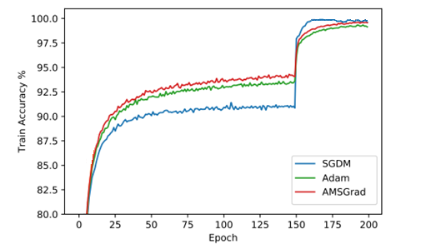
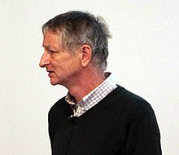
Common Trends – Problem with Moving Average
Bag of tunable
$$θ_{i+1}=θ_{i}−λg(θ_{i})$$
$$F(θ)$$
Direction of change
in $θ$to decay $F(θ)$
$$−{∇F(θ}_{i})$$
SGD noise is larger for
smaller batch size
$$g\left(θ_{i}\right)=∇F\left(θ_{i}\right)+e$$
$$E\left[g\left(θ_{i}\right)\right]≈∇F\left(θ_{i}\right)$$
$$θ_{i}$$
$$θ_{i}+δ_{estimate}$$
“Mini batches are usually better” Geoffrey Hinton, Lecture 6, CSC321, University of Toronto AI scientist at Google Brain
Training accuracy for ResNet-34, CIFAR10
Adaptive Gradient Methods with Dynamic Bound of Learning Rate
Luo et al. ICLR 2019

Slide 38
Common Trends – Manual Tuning
Bag of tunable
$$θ_{i+1}=θ_{i}−λg(θ_{i})$$
Multi-step decay – input: (initial step size, [milestone], [decay])
$$F(θ)$$
Direction of change
in $θ$to decay $F(θ)$
$$−{∇F(θ}_{i})$$
learning rate: $λ$
Initial value
decay 1
decay 2
$$θ_{i}$$
$$θ_{i}+δ_{tuned}$$
$$θ$$
decay 3
step or epoch
number
milestone 1
milestone 2
milestone 3

Slide 39
Common Trends – Combining Techniques
Bag of tunable
$$θ_{i+1}=θ_{i}−λA_{i}$$
$$F(θ)$$
Direction of change
in $θ$to decay $F(θ)$
$$−{∇F(θ}_{i})$$
ADAM
$$A_{i}=\frac{E\left[g\left(θ_{i}\right)\right]}{\sqrt{E^{2}[g\left(θ_{i}\right)]}+ε}$$
Multi-step decay
(initial step size, [milestone], [decay])
$$θ_{i}$$
$$θ$$
$$θ_{i}+δ$$

Slide 40
A Greedy Scheduler for Learning Rate – Inspirations
Second order information: learning rate can both increase and decrease during training

Slide 41
A Greedy Scheduler for Learning Rate – Inspirations
Second order information: learning rate can both increase and decrease during training
Using moving average: damping the SGD noise can hurt the final results

Slide 42
A Greedy Scheduler for Learning Rate – Inspirations
Second order information: learning rate can both increase and decrease during training
Using moving average: damping the SGD noise can hurt the final results
Gradually changing the learning rate is better than sudden changes
Learning
rate
Sudden
change
Learning
rate
Smooth
change
step or epoch
number
step or epoch
number

Slide 43
A Greedy Scheduler for Learning Rate – Inspirations
Second order information: learning rate can both increase and decrease during training
Using moving average: damping the SGD noise can hurt the final results
Gradually changing the learning rate is better than sudden changes
We have to walk on a pathological curvature
$$F(θ)$$
$$f\left(α,β\right)$$
$$β$$
How this visualization was created!?
$θ$ is a high dimensional vector and we cannot plot $F\left(θ\right)$
A two dimension function is plotted:
$$f\left(α,β\right)=F\left(θ^{∗}+αδ+βη\right)$$
The loss surface of ResNet-56 without skip connections
“Visualizing the Loss Landscape of Neural Nets”, Li et al. NIPS 2018
$$θ$$
$$α$$

Slide 44
A Greedy Scheduler for Learning Rate – The Algorithm
Take an initial learning rate as input: $C=initial learning rate$
Possible learning rates
Initial
learning rate
epoch
number

Slide 45
A Greedy Scheduler for Learning Rate – The Algorithm
Take an initial learning rate as input: $C=initial learning rate$
Draw learning rates (per layer) from a uniform distribution
Possible learning rates
Initial
learning rate
min
$$C$$
max
epoch
number
$$P\left(x\right)=\frac{1}{max−min}$$

Slide 46
A Greedy Scheduler for Learning Rate – The Algorithm
Take an initial learning rate as input: $C=initial learning rate$
Draw learning rates (per layer) from a uniform distribution
Possible learning rates
Initial
learning rate
min
$$C$$
max
epoch
number
$$P\left(x\right)=\frac{1}{max−min}$$

Slide 47
A Greedy Scheduler for Learning Rate – The Algorithm
Take an initial learning rate as input: $C=initial learning rate$
Draw learning rates (per layer) from a uniform distribution
Possible learning rates
Input: $C$
scale = ${10}^{int(\log_{10}{C})}$
decimal = $int(\frac{C}{scale})$
max = (decimal+0.5)*scale
min = (decimal-0.5)*scale
Initial
learning rate
epoch
number
min
$$C$$
max

Slide 48
A Greedy Scheduler for Learning Rate – The Algorithm
Take an initial learning rate as input: $C=initial learning rate$
Draw learning rates (per layer) from a uniform distribution
Possible learning rates
Input: $C$
scale = ${10}^{int(\log_{10}{C})}$
decimal = $int(\frac{C}{scale})$
max = (decimal+0.5)*scale
min = (decimal-0.5)*scale
$$C=0.2$$
$$scale=0.1$$
$$decimal=2$$
$$max=0.25$$
$$min =0.15$$
Initial
learning rate
epoch
number
min
$$C$$
max

Slide 49
A Greedy Scheduler for Learning Rate – The Algorithm
Take an initial learning rate as input: $C=initial learning rate$
Draw learning rates (per layer) from a uniform distribution
Possible learning rates
Input: $C$
scale = ${10}^{int(\log_{10}{C})}$
decimal = $int(\frac{C}{scale})$
max = (decimal+0.5)*scale
min = (decimal-0.5)*scale
$$C=0.02$$
$$scale=0.01$$
$$decimal=2$$
$$max=0.025$$
$$min =0.015$$
Initial
learning rate
epoch
number
min
$$C$$
max

Slide 50
A Greedy Scheduler for Learning Rate – The Algorithm
Take an initial learning rate as input: $C=initial learning rate$
Draw learning rates (per layer) from a uniform distribution
Possible learning rates
Input: $C$
scale = ${10}^{int(\log_{10}{C})}$
decimal = $int(\frac{C}{scale})$
max = (decimal+0.5)*scale
min = (decimal-0.5)*scale
$$C=0.1$$
$$C=0.02$$
$$scale=0.01$$
$$decimal=2$$
$$max=0.025$$
$$min =0.015$$
$$C=0.09$$
$$C=0.08$$
Initial
learning rate
$$C=0.01$$
$$C=0.009$$
$$C=0.008$$
epoch
number
min
$$C$$
max

Slide 51
A Greedy Scheduler for Learning Rate – The Algorithm
Take an initial learning rate as input: $C=initial learning rate$
Draw learning rates (per layer) from a uniform distribution
Change the learning rate ($C$), when validation loss is not smaller than the smallest value so far
Possible learning rates
Validation loss did not improve
loss
Initial
learning rate
epoch
number

Slide 52
A Greedy Scheduler for Learning Rate – The Algorithm
Take an initial learning rate as input: $C=initial learning rate$
Draw learning rates (per layer) from a uniform distribution
Change the learning rate ($C$), when validation loss is not smaller than the smallest value so far:
If validation loss is improved, continue with the current learning rate
Validation loss has been improved
continue with the current learning rate
Possible learning rates
loss
Initial
learning rate
epoch
number

Slide 53
A Greedy Scheduler for Learning Rate – The Algorithm
Take an initial learning rate as input: $C=initial learning rate$
Draw learning rates (per layer) from a uniform distribution
Change the learning rate ($C$), when validation loss is not smaller than the smallest value so far:
If validation loss is improved, continue with the current learning rate
If not, start with “radius=1”, check the neighboring learning rates and increase radius by 1
Possible learning rates
radius = 1
loss
Initial
learning rate
epoch
number

Slide 54
A Greedy Scheduler for Learning Rate – The Algorithm
Take an initial learning rate as input: $C=initial learning rate$
Draw learning rates (per layer) from a uniform distribution
Change the learning rate ($C$), when validation loss is not smaller than the smallest value so far:
If validation loss is improved, continue with the current learning rate
If not, start with “radius=1”, check the neighboring learning rates and increase radius by 1
Possible learning rates
radius = 2
loss
Initial
learning rate
epoch
number

Slide 55
A Greedy Scheduler for Learning Rate – The Algorithm
Take an initial learning rate as input: $C=initial learning rate$
Draw learning rates (per layer) from a uniform distribution
Change the learning rate ($C$), when validation loss is not smaller than the smallest value so far:
If validation loss is improved, continue with the current learning rate
If not, start with “radius=1”, check the neighboring learning rates and increase radius by 1
Possible learning rates
radius = 3
loss
Initial
learning rate
epoch
number

Slide 56
A Greedy Scheduler for Learning Rate – The Algorithm
Take an initial learning rate as input: $C=initial learning rate$
Draw learning rates (per layer) from a uniform distribution
Change the learning rate ($C$), when validation loss is not smaller than the smallest value so far:
If validation loss is improved, continue with the current learning rate
If not, start with “radius=1”, check the neighboring learning rates and increase radius by 1
Possible learning rates
radius = 4
loss
Initial
learning rate
epoch
number

Slide 57
A Greedy Scheduler for Learning Rate – The Algorithm
Take an initial learning rate as input: $C=initial learning rate$
Draw learning rates (per layer) from a uniform distribution
Change the learning rate ($C$), when validation loss is not smaller than the smallest value so far:
If validation loss is improved, continue with the current learning rate
If not, start with “radius=1”, check the neighboring learning rates and increase radius by 1
Possible learning rates
radius = 3
loss
Initial
learning rate
epoch
number

Slide 58
A Greedy Scheduler for Learning Rate – Implementation
Training with step decay scheduler*
Training with our scheduler*
net = prepare_model(args.model)
optimizer = SGD(net.parameters(), lr=lr)
scheduler = MultiStep(milestones, gamma)
for number of epochs:
train_loss = train(optimizer)
val_loss = validate()
scheduler.step()
logInfo()
net = prepare_model(args.model)
optimizer = SGD (net.parameters(), lr=lr)
scheduler = GreedyLR()
for number of epochs:
train_loss = train(optimizer)
val_loss = validate()
scheduler.step(val_loss)
logInfo()
https://gitenterprise.xilinx.com/alirezak/experiments_scheduler/blob/master/greedy_scheduler.py
* Steps are simplified

Slide 59
Results – ResNet56
Top1
accuracy
Original hyperparameters*: 93.8%
Our scheduler: 93.9%
Paper: 93.0%
*obtained from: keras.io/examples
epoch
Learning
rate
0.02
0.01
0.009
step

Slide 60
Results – ResNet20
Top1
accuracy
Original hyperparameters*: 91.9%
Our scheduler: 91.8%
Paper: 91.2%
*obtained from: gihub.com/osmr
epoch
Learning
rate
step

Slide 61
Results – ResNet20
Top1
accuracy
Original hyperparameters*: 92.3%
Our scheduler: 92.6%
Paper: 91.2%
*obtained from: keras.io/examples
epoch
Learning
rate
step

Slide 62
Results – VGG11_Brevitas_8bit Brevitas: https://github.com/Xilinx/brevitas
Top1
accuracy
Original hyperparameters*: 91.5%
Our scheduler: 91.4%
*obtained from: gitenterprise.xilinx.com
step
Learning
rate
step

Slide 63
Results
Network CIFAR10 | Scheduler | Learning rate parameters (lr, milestones, gamma) | Top1 accuracy
Resnet20 | Step Decay | 0.1, [80,120,160,180], [0.1,0.1,0.1, 0.05] | 92.3%
 | Ours | 0.1 | 92.6%
Resnet56 | Step Decay | 0.1, [80,120,160,180], [0.1,0.1,0.1,0.05] | 93.8%
 | Ours | 0.1 | 93.9%
DenseNet40_k12 | Step Decay | 0.1, [150, 250], [0.1] | 93.0%
 | Ours | 0.1 | 92.9%
WRN20_10_1bit | Step Decay | 0.1, [80,120,160,180],[0.1] | 95.2%
 | Ours | 0.1 | 94.9%
VGG11 8bit-fixed | Step Decay | 0.1, [150,250,350], [0.1] | 91.5%
 | Ours | 0.1 | 91.4%
VGG11 6bit-fixed | Step Decay | 0.1, [150,250,350], [0.1] | 91.2%
 | Ours | 0.1 | 91.2%
CNV 1bit | Step Decay | 0.1, [500,600,700,800],[0.1] | 78.5%
 | Ours | 0.1 | 78.5%

Slide 64
Wrapping up, Why Does it Matter?
Network CIFAR10 | Scheduler | Learning rate parameters (lr, milestones, gamma) | Top1 accuracy
Resnet20 | Step Decay | 0.1, [80,120,160,180], [0.1,0.1,0.1, 0.05] | 92.3%
 | Ours | 0.1 | 92.6%
In contrast, our method can be forgiving.
For example:
If you get these numbers wrong (from guessing,
an online resource, a friend, etc.) you may not get good results.
For example:
Network CIFAR10 | Scheduler | Learning rate parameters (lr, milestones, gamma) | Top1 accuracy
Resnet20 | Step Decay | 0.2, [160,180], [0.1] | 90.7%
Network CIFAR10 | Scheduler | Learning rate parameters (lr, milestones, gamma) | Top1 Accuracy
Resnet20 | Step Decay | 0.2, [160,180], [0.1] | 90.7%
 | Ours | 0.2 | 92.6%

Slide 65
Disclaimer – There is no Silver Bullet for Deep Learning
We, similar to every single method out there, cannot
guarantee that our method works better all the time.

